Slide 1


React Native
While you wait:
Download The Expo App from the Play Store or App Store
Slides - ap.pn/2p90qqo
(C) 2017 Appian Corporation. Distribution with attribution permitted. All other rights reserved
Notes:
Play Store Logo: https://upload.wikimedia.org/wikipedia/commons/8/8f/New-Play-Store-logo.png
App Store Logo: https://upload.wikimedia.org/wikipedia/commons/4/46/Apple_Store_logo.svg

Slide 2
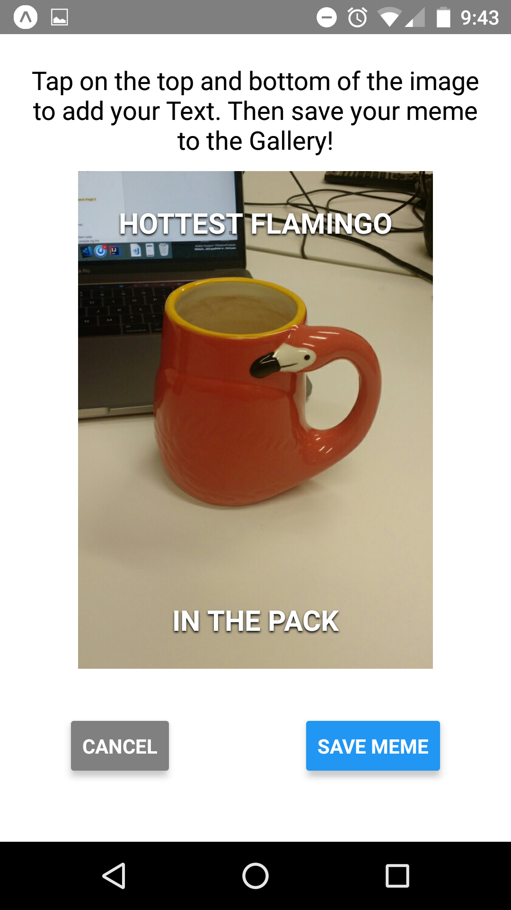
What are we building?
A Meme Creator App
Take a picture
Add text
Save your meme
Impress your friends with your original dank memes!

Slide 3

How are we building it?
Expo + Snack
Online IDE created by Expo for React Native development
You can create an app in Snack and share it easily with a QR code
To run it on your phone you just need the corresponding Expo app from the Play or App Store
If you haven’t already, open the slides: ap.pn/2p90qqo
Notes:
Download it from the Play/App store using the icons on the top right!

Slide 4
Why React Native?
Uses React Lifecycle
Cross-Platform
Reusable Components (Fast to write)
Simple State Management
Notes:
Cross-Platform means your RN apps can run on both android and iOS.
React Native enabled mobile development for Javascript developers! You don’t need to write native code for the App to work.

Slide 5
Structure of our App
App.js
Button to Take Photo
Shows meme editor when photo taken
Camera Api
Takes Photo
Photo
Meme Editor
Display Image
Enter Text
Save Meme
Cancel
Photo
Notes:
Show main components of project

Slide 6
Table of Contents
Section 1: Let’s take a picture!
What is a Component
Simple React Component Lifecycle
Console Logs
Waiting on an API
Demo: Taking a Picture
Section 2: Let’s see our image!
State + Props
Intro to Component: View
Intro to Component: Image
Intro to Component: Text
Demo: Showing your Image
Section 3: Let’s add text!
Styling your Application
Intro to Component: TextInput
Demo: Adding Text
Section 4: Let’s save it!
Intro to Component: CameraRoll
Demo: Saving your Meme
Additional Concepts
React Component Lifecycle
More on Building Components
More Styles + Layout with Flex
Sharing Code Across Files in JS
Variables - const, let & var
Set-up Local Development

Slide 7
What is a Component
class Greeting extends React.Component { render() { return <Text>Hello, {this.props.name}</Text>; } }
Components let you split the UI into independent, reusable pieces, and think about each piece in isolation - React Docs
React Component Documentation
Notes:
(Without going into specifics, emphasize that these are the basic building blocks of react & react native)
Ideas to get across:
Components are reusable
You can use your components in other components
Components are isolated
Components are the basic building blocks of a react native application
Props are how you pass variables into your components.
State is how you save information inside of a component.

Slide 8
Simplified React Lifecycle
Update
render()
Mounted
Unmounted
setState()
OR
setProps()
render()
Notes:
Components go through three different parts of the lifecycle: mounting, updating and unmounting.
Mounting is for the initial render, updating is for any successive render, and unmounting if for when the component is removed.
Check out the React docs to learn about the functions that React provides during these parts of the lifecycle!
In this app, we are focusing on the constructor, which initializes state for the component (Mounting phase), and the render function, which returns the structure for the component (i.e. how it looks). Note that the render function is used in both the mounting phase (i.e. the initial render), and the updating phase.

Slide 9
Javascript Functions
Normal JS Functions
function myFunction() { return <Text>Hello, World!</Text>; }
Arrow Functions (aka “Fat Arrow” Functions)
myBoundFunction = () => { return <Text>Hello, {this.props.world}</Text>; }
Normal JS Functions
Arrow Functions
Notes:
Talk about javascript functions, and briefly talk about ES6 fat arrow functions.
Fat arrow functions are what we use in react classes to be able to use the “this” variable inside of those functions to access props and state.
For fat arrow functions you don’t need the function keyword

Slide 10
Demo Concepts
Notes:
Here we want to explain that for each of our demos, we will first explain concepts and then go through a coding exercise!

Slide 11
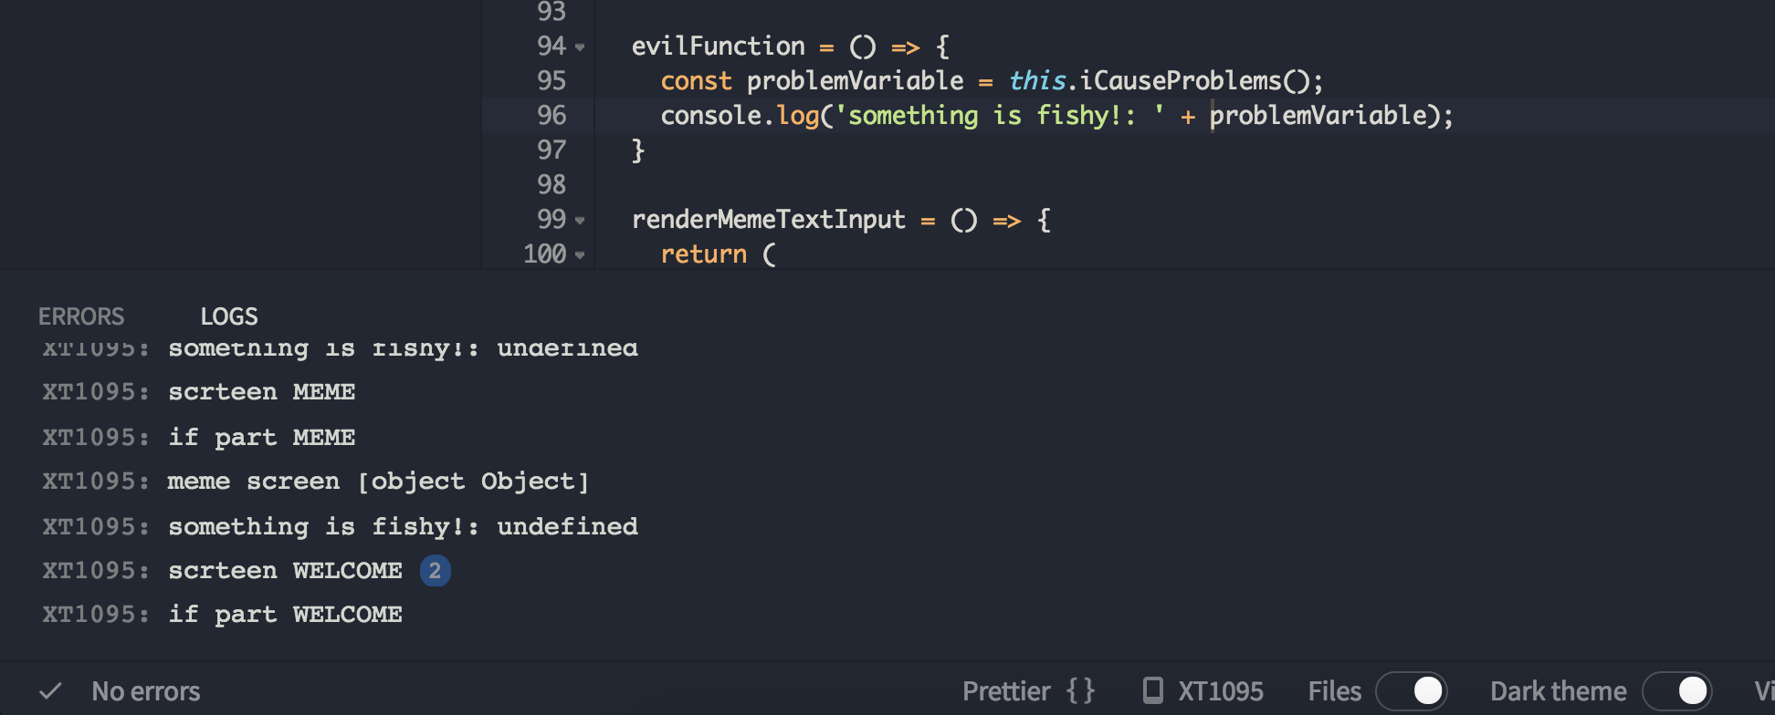
Console Logs are our Friends
When you are debugging try using console.log(); to print out variables and see where your code is breaking.
Click on the bottom bar in expo to open the log/error drawer.
I see you undefined variable!

Slide 12
Waiting on an API
Some functions may take time to return a result (networking, user interaction, slow processing). We use async & await for these occasions. (The docs for an api will tell you if it is needed).
The Camera Api is an example of this!
our function must have the “async” keyword to have an await
takePhoto = async () => {
console.log(‘taking photo’);
let img = await Expo.ImagePicker.launchCameraAsync();
if (!img.cancelled) {
console.log(‘photo taken’);
this.setState({ photo: img, screen: memeScreen });
}
};
await the image to return
now we can use the image!
Notes:
JS itself is not pausing and can still do other stuff. Instead the code after the await is being treated as a callback.
-- Talk about what happens when you call an async function in javascript
-- When you call an async function, it executes until you hit an await and then everything after the await acts as a callback when that function returns.
Talk about await!
If you have an await in your function you need to make it async!
If you don’t know if something should be called with await, look at the docs for it, normally the developer who wrote it will tell you.

Slide 13
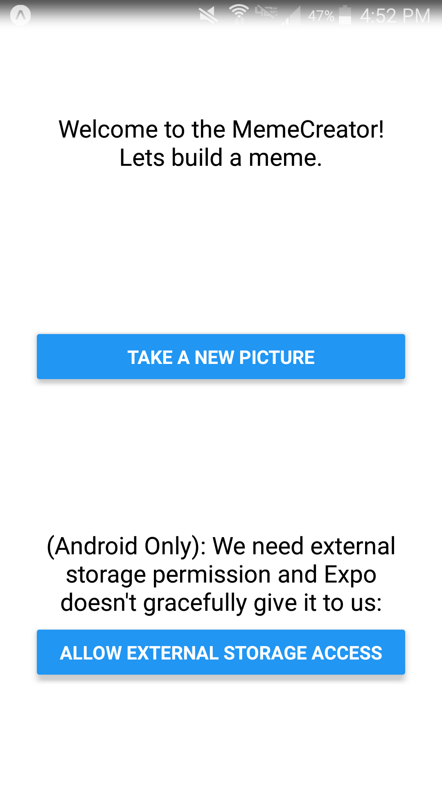
Demo: Taking a Picture
Key Concepts:
Async and Await
Expo Console for logs
Steps:
Use the launchCameraAsync() function to take a photo.
We’ll console log the result to make sure it’s taken!
Start coding on Expo from here
See the changes on Github
Notes:
Explain that we built out a portion of the App before this workshop.
Point out what a function looks like in our App.
Point out that the toolbar to click currently has an eslint error -- mention that Expo will find a lot of errors in your code.
Mention that if you get lost, take a look at the git diff -- red lines are for lines that get removed and green lines get added.

Slide 14
Adding Components: State and props
Props: “parameters” to a constructor. Values that we pass into our component*
State: “fields” in a class Changing these causes the component to rerender
Props & State in OnOffSwitch
export default class OnOffSwitch extends Component {
constructor(props) {
super(props);
// Set Initial State
this.state = { isOn: false };
}
render = () => { // Render method that controls what shows on UI
const buttonText = this.state.isOn ? "ON" : "OFF";
const buttonColor = {backgroundColor: this.props.color};
return (
<Text onPress={this.onPress}>
{buttonText}
</Text>
);
}
onPress = () => {
this.setState({ isOn: !this.state.isOn });
}
}
export default class App extends Component {
...
render() {
return <OnOffSwitch color=’blue’>;
}
}
Props Passed from App.js
Notes:
* Props can not be modified form inside our component, only passed in.
** Here we can see an example of App.js passing props into OnOffSwitch (the color)
* State is used for storing values in a component, when you change them they will cause the component to redraw.
** State is used to control the text of a button in this example (off and on)
** We set the initial value of the state using the constructor
** We can change the value of the state by calling “setState” as seen in the onPress callback. Here we flip the value of “isOn” when we press the text.
** The view will get redrawn with the new text when we set State
** So this button will switch between saying “on” and “off” when someone presses it.

Slide 15
React Native Components
Basic
User Interface
iOS
Android
Others
View
StyleSheet
Image
Text
TextInput
Button
Picker
Switch
DatePickerIOS
AlertIOS
NavigatorIOS
ToastAndroid
BackHandler
ToolbarAndroid
Animated
Modal
CameraRoll
Notes:
From Nisha’s comment: User is User interface. As per RN docs, the components listed under `User Interface` are the ones that render common UI controls. Components listed under `Basic` are the very basic components we need to know for a RN app.

Slide 16
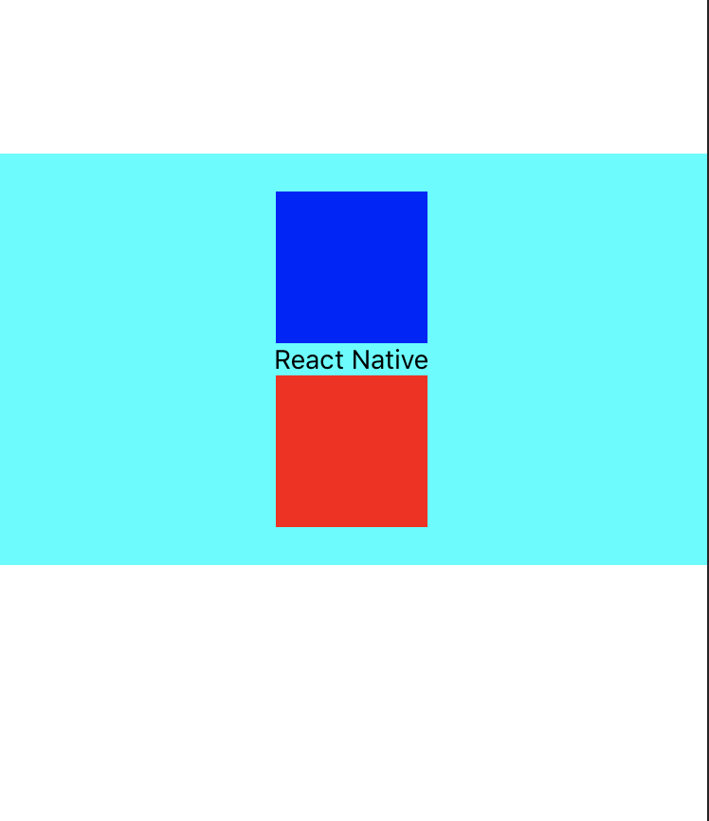
Basic Components: View
View
A container for laying out your UI
You can nest other Views or components inside
Styling is done with the “style prop”
<View style={{backgroundColor: 'cyan', … }}>
<View style={{backgroundColor: 'blue', … }} />
<Text>React Native</Text>
<View style={{backgroundColor: 'red', … }}/>
</View>
Nested Views
Nested Text
Notes:
Can have 0 to many children
The code that is shown could be returned by the render function of a component.
This syntax is called jsx, it is very similar to html!
Note that any javascript in our jsx has to be surrounded by curly brackets “{}”
Say that if you’re familiar with web development, a View in RN is like a div in web dev

Slide 17

Basic Components: Image
Pass in a url to a local image or image on the web. And it will display it!
Manually specify dimensions for images
Displays most image formats*
<View style={{...}}>
<Image
style={{width: 150, height: 150}}
source={{uri: 'https://d7um…..png'}} />
</View>
Notes:
*Gif and WebP are not supported on android out of the box:
WebP is a method of lossy and lossless compression that can be used on a large variety of photographic, translucent and graphical images found on the web. The degree of lossy compression is adjustable so a user can choose the trade-off between file size and image quality.
To use these formats, add some optional modules in android/app/build.gradle, depending on the needs of app.
We could mention that if you don’t pass in a style, the image won’t appear on the screen.

Slide 18

Basic Components: Text
Displays text
Supports nesting, styling and touch handling
<View style={{...}}>
<Text onPress={() => Alert.alert('Incredibly awesome!')}>
RN Workshop
<Text style={{color: 'red', fontSize: 20}}>
{' '}is awesome?
</Text>
</Text>
</View>

Slide 19
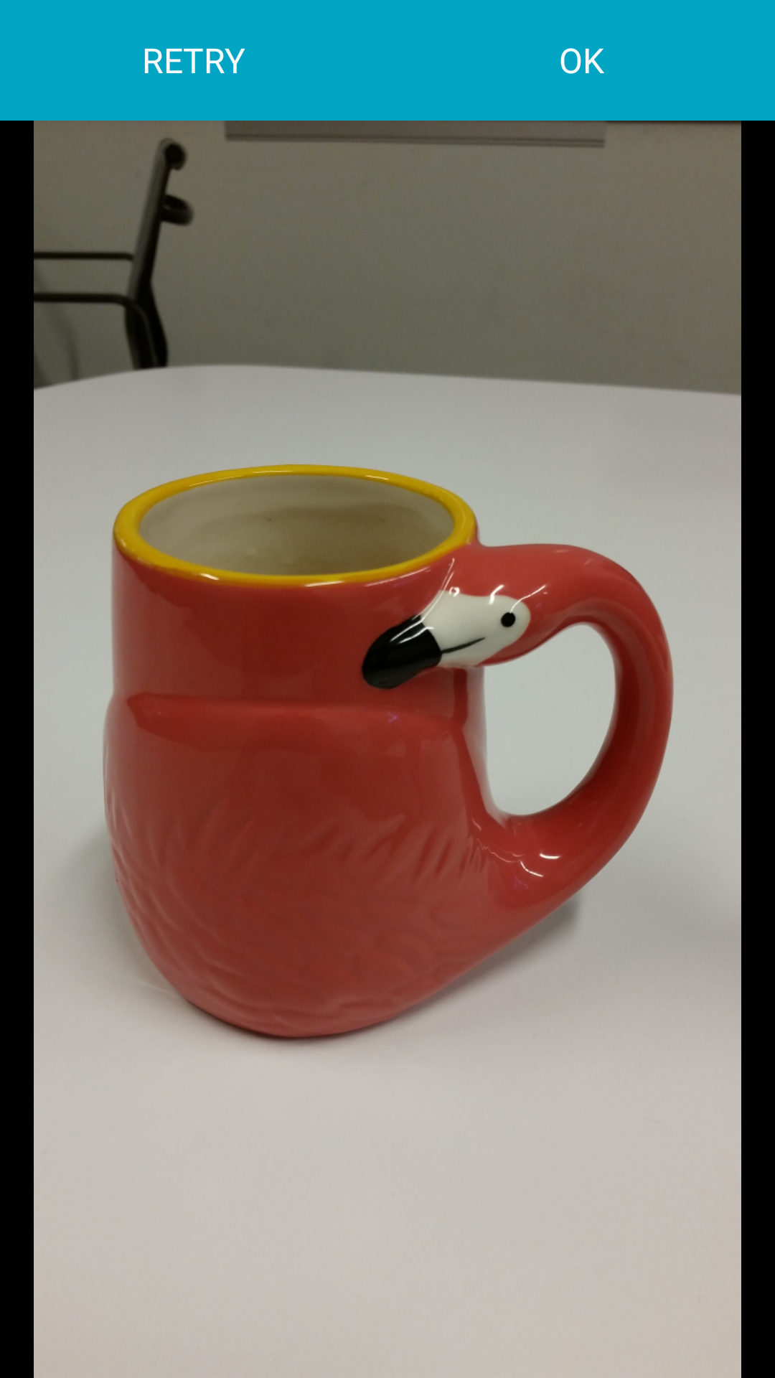
Demo: Showing your image
Key Concepts:
View and Image Components
State and Props
Steps:
Update the state that determines what screen to show
Display the image we took
TODO
Start coding on Expo from here
See the changes on Github

Slide 20
Styles: Basics
Let you customize your components
We pull our styles out of our JSX, and into stylesheets*
const styles = StyleSheet.create({
viewStyle: {
padding: 20,
alignItems: ‘center’,
marginTop: 100
},
imageStyle: {
width: 150,
height: 150
}
});
<View style={{
padding: 20,
alignItems: 'center',
marginTop: 100
}}>
<Image
style={{width: 150, height: 150}}
source={{uri: '…'}} />
</View>
<View style={styles.viewStyle}>
<Image
style={styles.imageStyle}
source={{uri: '…'}} />
</View>
=
+
*refer to slide notes for details
Notes:
There are 2 approaches to finding styles:
Look through the style docs for Text and View (do this at least once)
Google “how to do <this particular style> in React Native”
We pull our styles out of our JSX, and into stylesheets (more on the next slide)
There is more on styles and layout with flex in the appendix

Slide 21
Styles: Stylesheets
Why Stylesheets?
Makes code readable
Reusable
Easier to maintain
const styles = StyleSheet.create({
viewStyle: {
padding: 20,
alignItems: ‘center’,
marginTop: 100
},
imageStyle: {
width: 150,
height: 150
}
});
<View style={styles.viewStyle}>
<Image
style={styles.imageStyle}
source={{uri: '…'}} />
</View>
Notes:
We could delete this slide and cover the info on the previous slide, but I don’t hate repeating the slide here -- it gives students longer to absorb it!

Slide 22
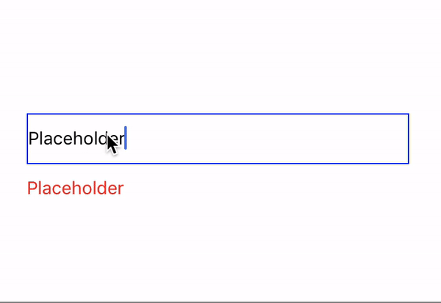
Basic Components: TextInput
Input text in App via keyboard
<View style={{...}}>
<TextInput
style={{...}}
onChangeText={(text) => this.setState({text})}
value={this.state.text}
/>
<Text style={{...}}>{this.state.text}</Text>
</View>
Notes:
Subscribe to the onChangeText events to read the user input. There are also other events, such as onSubmitEditing and onFocus that can be subscribed to. In TextInput
We talk a lot about props here too, maybe we should introduce state and props earlier?

Slide 23
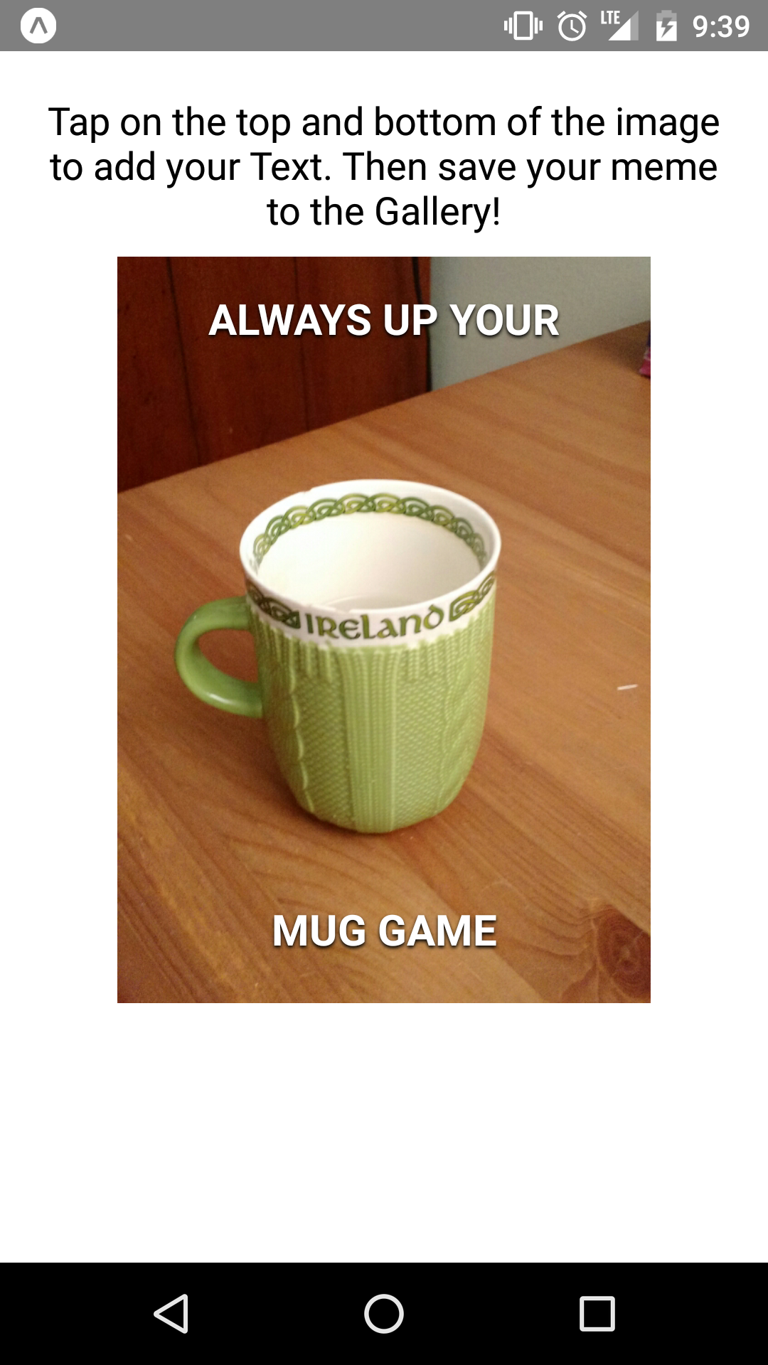
Demo: Adding Text to your Meme
Key Concepts:
Styling
State and Props
Steps:
Change Image to ImageBackground
Add two text fields on our image + styles
Start coding on Expo from here
See the changes on Github

Slide 24
CameraRoll
Access to device’s camera roll
saveToCameraRoll()
saves photo/video to camera roll
getPhotos()
Gets photo from the camera roll
const result = await takeSnapshotAsync (this.ref, {
format: 'png',
result: 'file',
});
await CameraRoll. saveToCameraRoll (result, 'photo');
Notes:
saveToCameraRoll() -> Returns a promise which will resolve with the new URI. On iOS, we can use remote URLs. On Android, we need to download the file before saving it (i.e., the URI should be local image or video URI)
getPhotos() -> It takes an object with some configuration as parameters and returns a promise
takeSnapshotAsync -> screenshot that current view and return an image(based on the options specified)
Refrences: https://www.codementor.io/blessingoraz/access-camera-roll-with-react-native-9uwupuuy0
https://medium.com/react-native-training/mastering-the-camera-roll-in-react-native-13b3b1963a2d

Slide 25
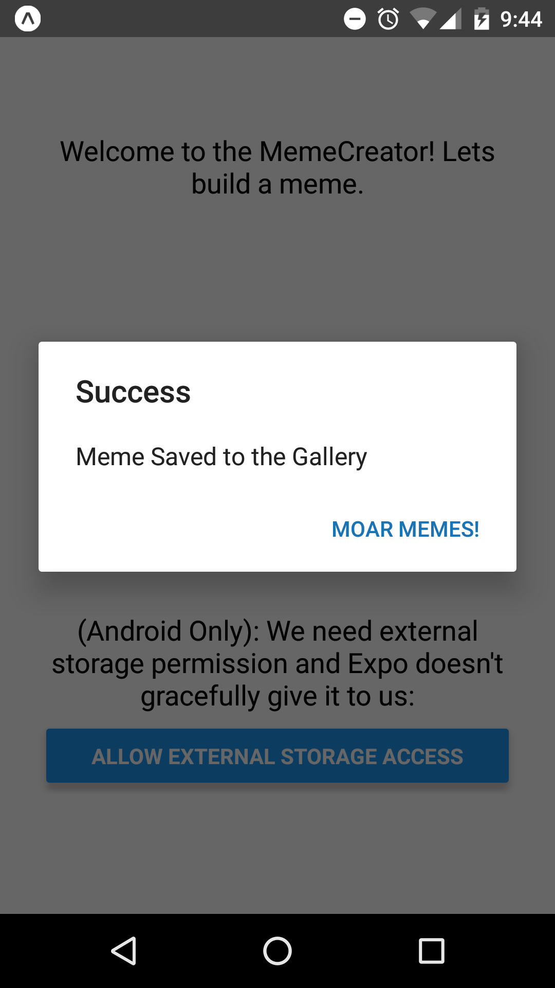
Demo: Saving Your Meme
Key Concepts:
State and Props
Steps:
Add a save button with an onPress Listener
Save the image and close the editor, in our “onPress” callback
Start coding on Expo from here
See the changes on Github
Notes:
Cancellable: On Android, alerts can be dismissed by tapping outside of the alert box. The dismissing behavior can be disabled altogether by providing an optional options parameter with the cancelable property set to false

Slide 26
Thank you for joining us!
Please click here or go to ap.pn/2oYN4Nx to share feedback
Next Step: Add a cancel button that just closes the editor
Start coding on Expo from here

Slide 27
Additional Concepts

Slide 28
Detailed React Component Lifecycle
Mounting (Creating)
Updating
Unmounting (Destroying)
constructor
componentWillReceiveProps
componentWillUnmount
componentWillMount
shouldComponentUpdate
true
false
componentWillUpdate
render
render
componentDidMount
componentDidUpdate
Docs for the lifecycle methods
Notes:
Talk about:
Benefits of Component Lifecycle - most important concept in react
Constructor - used to initialize state -- and to initialize props (briefly introduce state here)
componentWillMount - used for any side effect functions that need to happen before “render”
Render - Most Important
componentDidMount: used for making network requests -- also if you set the state in this function the user will not see a flash of the screen with the 2 render calls being called quickly.
If we have time, also talk about:
Component Did Mount
Should Component Update
Talk about efficiency of a react application
Component Did Update
Component Will Unmount

Slide 29
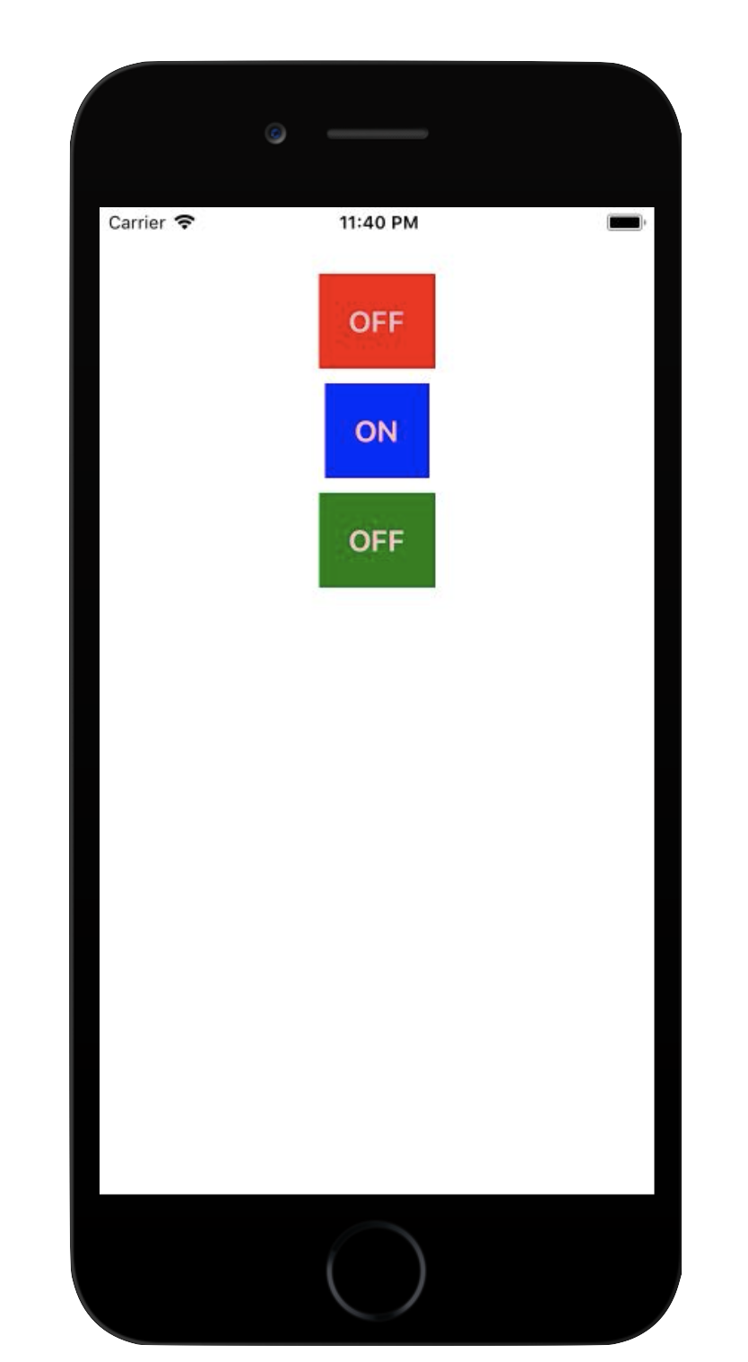
Adding Components
Let’s build an “on-off” button
We will put together our requirements, and find ways to achieve them.
Requirements
We want a reusable button
Button color can be configured
You can turn the button on and off
Text switches when you press
Try to think about your components this way!
Technical Approach
Make a component
Pass color in as a prop
Have a state variable
An onPress listener is needed
Notes:
We may want to make a component that RN doesn’t have!
In our case let’s create an on off switch, it’ll be a button which is red when on and green when off
We will make the button text customizable.

Slide 30
Adding Components: Building onOffSwitch
import React, { Component } from 'react';
import { Text, TouchableOpacity, StyleSheet } from 'react-native';
export default class OnOffSwitch extends Component {
constructor(props) {
super(props);
this.state = { isOn: false };
}
toggle = () => {
this.setState({ isOn: !this.state.isOn });
}
render = () => {
const buttonText = this.state.isOn ? "ON" : "OFF";
const buttonColor = {backgroundColor: this.props.color};
return (
<TouchableOpacity style={[styles.button, buttonColor]}
onPress={this.toggle} >
<Text style={styles.buttonText}>{buttonText}</Text>
</TouchableOpacity>
);
}
}
Imports
Class Creation + export (making it visible to other files)
Initial state
Callbacks + Changing State
Props
Render + other lifecycle methods
Notes:
When building a react or react native components you will need to do a couple of standard things:
Add your imports
Create your class
Set up any initial state
Add callbacks for changing state
And use your state and props in your render
You can also have other lifecycle methods if needed.

Slide 31
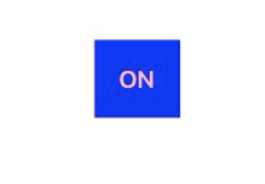
Styling: Basics
Create Your Styles
const styles = StyleSheet.create({
button: {
padding: 20,
Margin: 5,
backgroundColor: 'blue'
},
buttonText: {
fontSize: 20,
fontWeight: 'bold',
color: 'pink'
}
});
Component with style applied
<TouchableOpacity style={styles.button}>
<Text style={styles.buttonText}>
{'On'}
</Text>
</TouchableOpacity>
Rendered view
2 approaches to finding styles:
Look through the style docs for Text and View (do this at least once)
Google “how to do <this particular style> in React Native”

Slide 32
Styling: Laying out views
Flex is a set of styles for laying out views in React Native
flexDirection: row vs column
justifyContent: alignment in flexDirection
alignItems: alignment in cross-Direction
flex: how big the view should be (relative to its neighbors)
Here, the container has no neighbors So it takes up the full height
These are the basics, if you want to know more check this flex game out.
container: {
flexDirection: 'column',
justifyContent: ‘start’,
alignItems: 'center',
flex: 1
}
Notes:
Most Styles are straightforward, then there is flex
Flex is the Layout system for web and React Native. Here are the related styles:
flexDirection - controls whether your views are laid out horizontally or vertically
flex - controls whether your view’s size relative to other views in the same row or column
justifyContent - controls how your views are aligned
alignItems - same as justifyContent (but in the perpendicular direction)

Slide 33
Sharing Code across files in JS
We split our js code into different files for cleanliness, these are called modules. To share code with other files we need to “export” it. Then, other files can “import” what they need.
ModuleOne.js
ModuleTwo.js
export const number1 = 1;
export const number2 = 2;
default export function add(x, y) {
return x + y;
}
import add, {number1, number2} from ‘./ModuleOne.js’;
function solve() {
return add(number1, number2);
}
You can export multiple things from a file. But only one labeled “default”. The non “default” exports are listed in curly brackets. The “default” one is not.

Slide 34
Variable Declarations: Const, Let, Var
const | Variable is instantiated once and cannot be changed
let | Variable can be changed and is scoped to the nearest enclosing block
var | Variable can be changed and scoped to the nearest function block

Slide 35
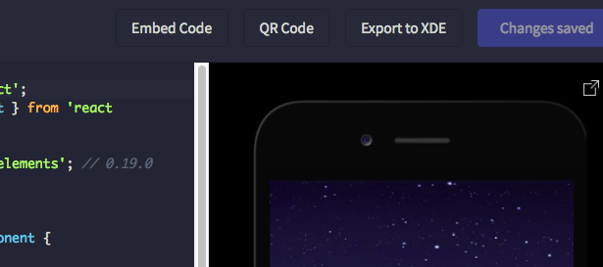
Setup Local Development
3
Install node.js + yarn
Install Expo XDE (App) or the Expo Command Line Tool
“Export” your project from snack
Unzip the download
Open the folder in a code editor
In the Command Line, go to the root of the project and run “yarn install”
If using the command line tool:
Run “exp start” and scan the barcode shown
If using the Expo XDE:
Open the project in Expo XDE and “Share” it to your device.
Scan the displayed barcode with the expo app on your phone.
Notes:
In the command line:
Go to the root directory of the project
Run “yarn install”
Run “exp start”
FYI: Yarn is an alternative to NPM

